Slide 1
Leisure Life
Online Bookstore
Presented By :
Sanzida Akter
Sumaita Hussein
Notes:
NOTE:
To change the image on this slide, select the picture and delete it. Then click the Pictures icon in the placeholder to insert your own image.

Slide 2
Definition :
It is an online book shopping site.
By which user can put details of books and user can search it, can be a member of this site, buy books .
User can view online book detail from anywhere through internet and purchase it .

Slide 3
Advantages of buying book online :
There are various factors which influence a person’s online experience.
Huge variety at one place.
Easy to operate website design and hassle-free shopping.
Books are properly categorized which reduces time and effort.
Reviews give you an idea about which books are worth reading.
Used books will be exchanged between users which saves more money.
Another main factor is that it reduces the need of going to a physical store or a book shop which requires time investment as you have to walk through various sections and read the synopsis or the blurb.

Slide 4
Objectives :
The main objectives of this project are :
User friendly navigations.
Maximize search options-
1.by author’s name
2.by book’s title
3.by subject
Help user by providing contents of books for reading.
User Interaction.

Slide 5
Websites We Used As Benchmark

Slide 6
https://www.rokomari.com/book
http://www.uofastore.com
https://www.brown.edu/campus-life/support/bookstore/featured-recommended
http://www.harvard.com/shelves/used_books/
http://www.uwbookstore.com/home.aspx
http://papertree.com.bd/cart/

Slide 7
Features We Like In Benchmark Websites

Slide 8
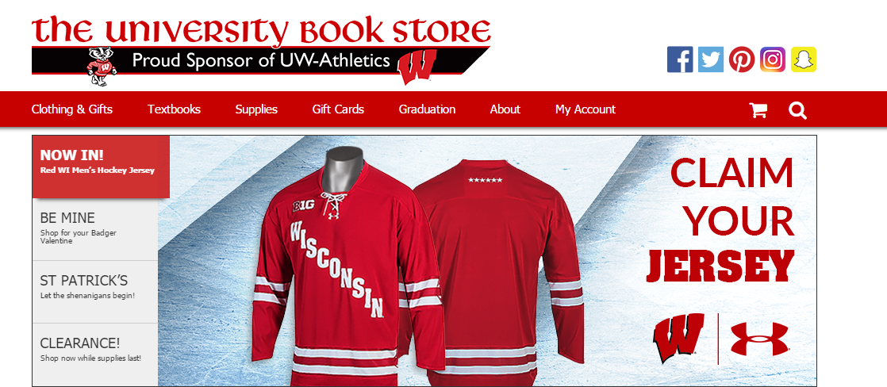

Slide 9
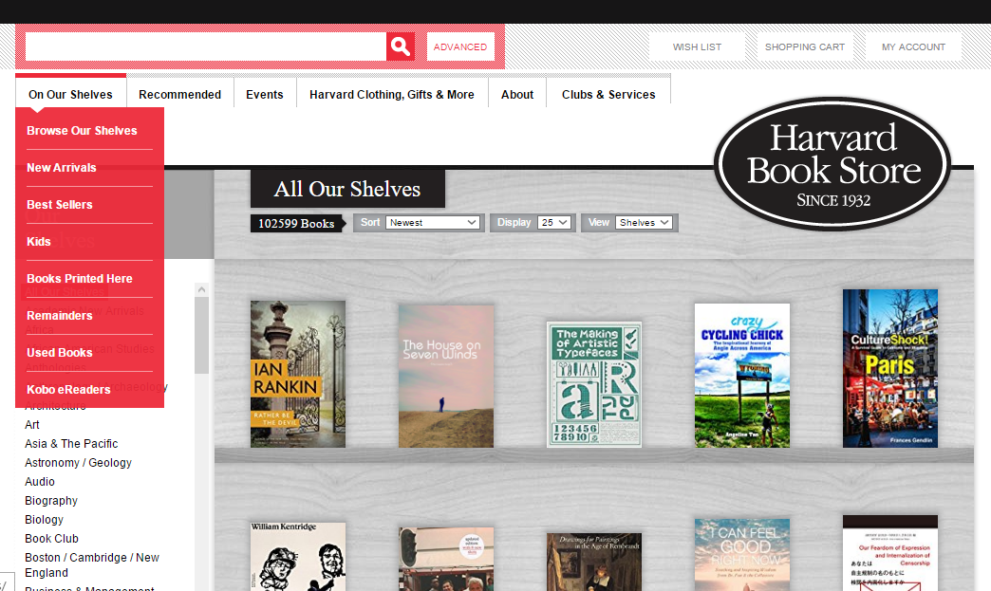

Slide 10
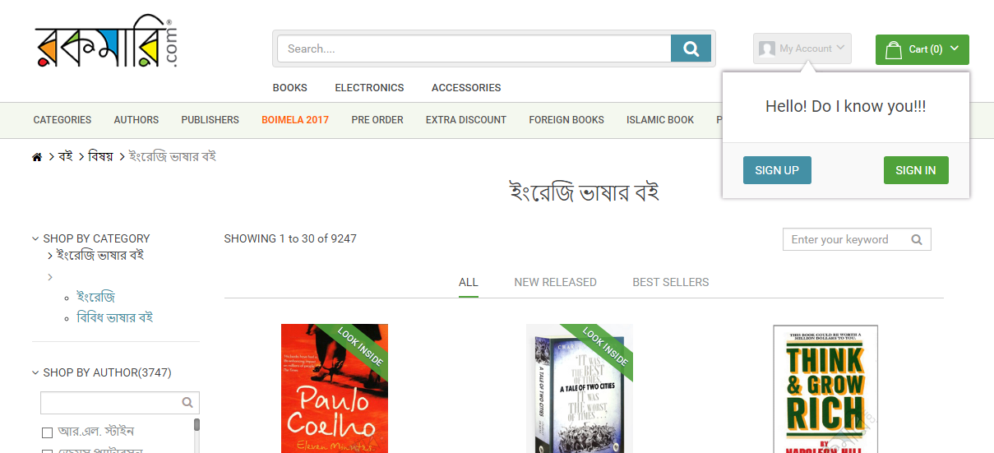

Slide 11
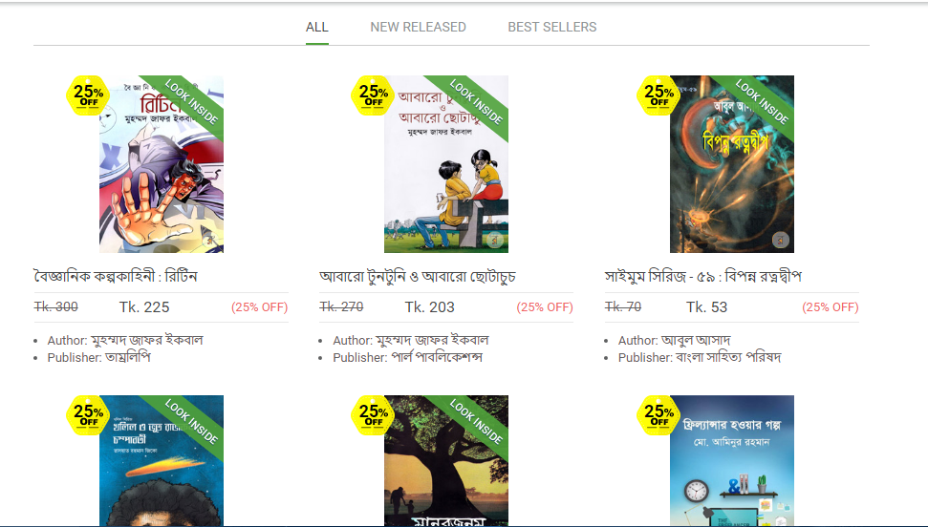

Slide 12
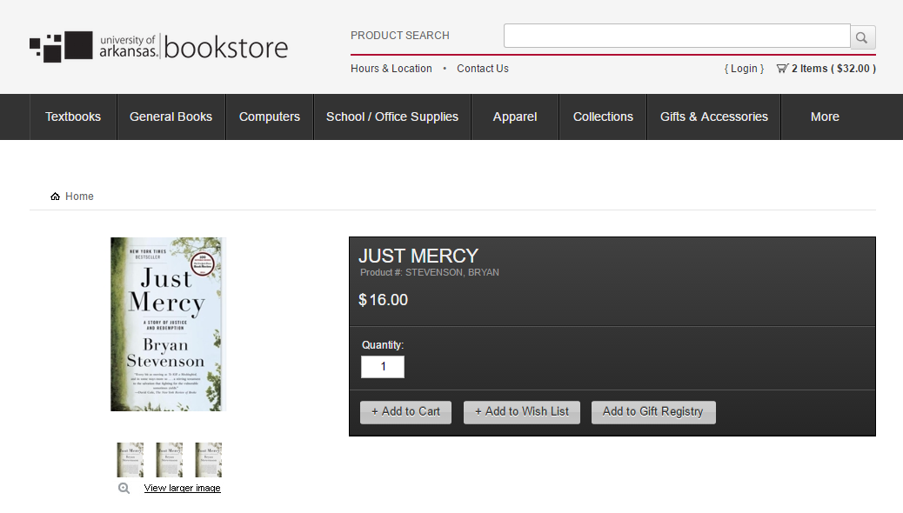

Slide 13
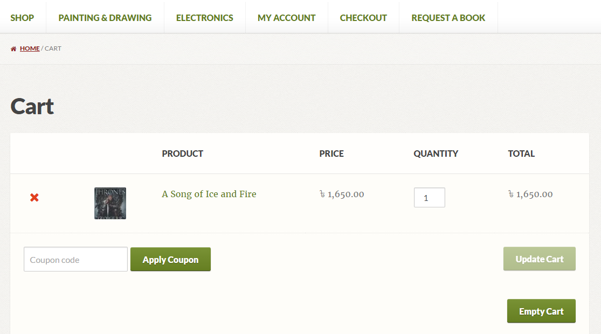

Slide 14
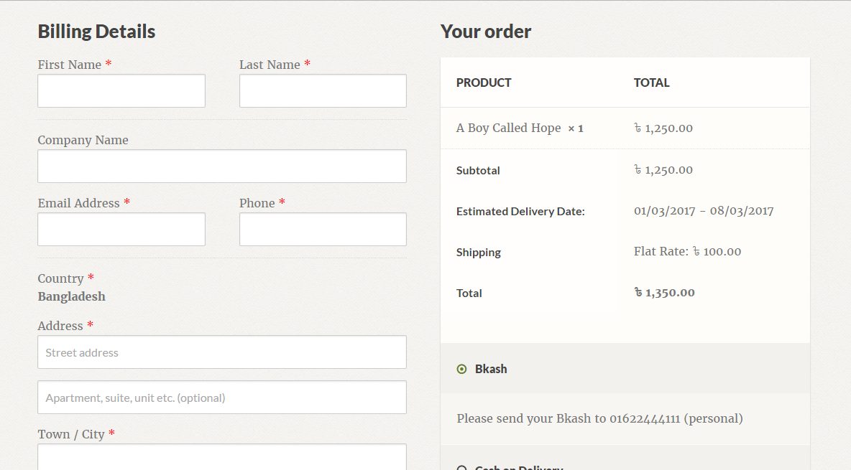

Slide 15
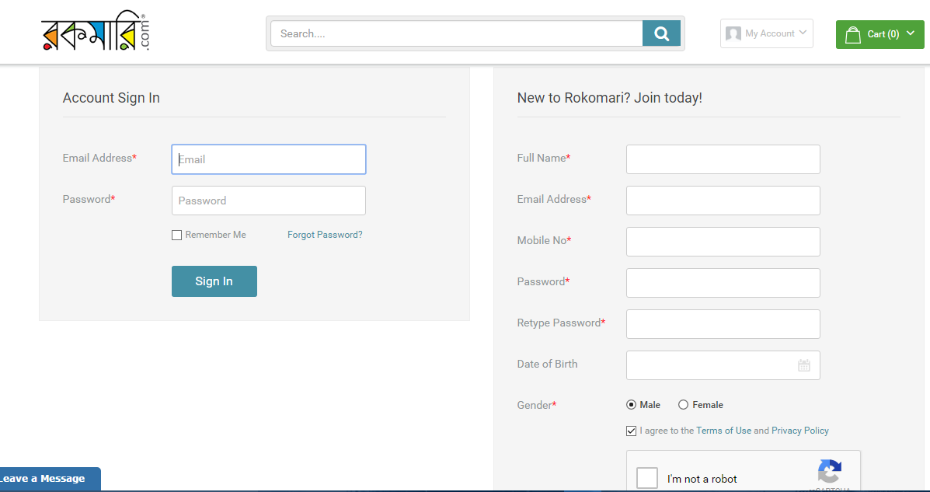

Slide 16
Our Project Features

Slide 17
Modules :
Home
Books
My Account
Shopping Cart
About

Slide 18
Books :
Browse our shelves
New Books
Used Books
Reviews

Slide 19
My Account :
Sign Up
Sign In

Slide 20
Shopping Cart :
No. of items
List of Books with price
Total Amount
Payments
Remove from cart

Slide 21
SWOT ANALYSIS
Strengths :
Use of Internet as a Storefront for Books services.
Customer Convenience.
Less Investment & fewer workforces for starting the venture.
Target market.
Minimum physical assets & less overhead charges on warehouses.
Cost effectiveness to the customers.
Post sales service of informing customers about new products & new auctions .

Slide 22
SWOT Analysis :
Weakness :
Supply of Books out of stock.
Dependent on external delivery services of courier services.
Need Constant maintenance of website.

Slide 23
SWOT Analysis :
Opportunities :
Online Bookstore.
Just a click away.
To develop relationship with Publishers to offer exclusive editions..
Collaborations with public sectors to provide rare & antique books.

Slide 24
SWOT Analysis :
Threats :
Local Bookshop vendors.
Price competition/war.
Increase in the Transportation costs by the courier company.
Low consumer confidence to buy using online systems.
Monopoly in Online business held by some players.

Slide 25
Design of The Webpages via Mockups

Slide 26
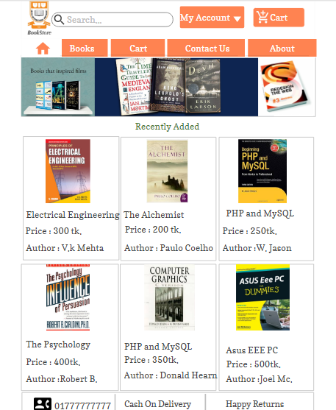
HOME PAGE

Slide 27
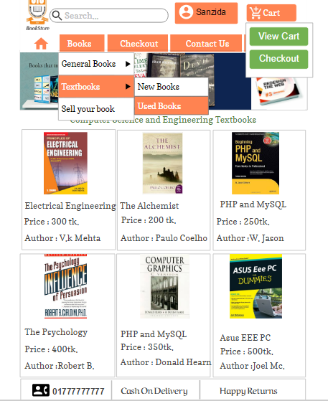
SUB MENU PAGE

Slide 28
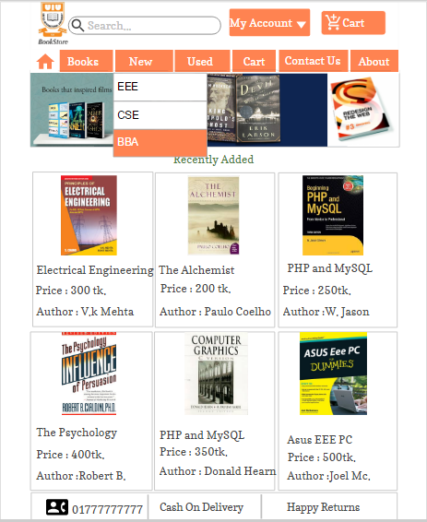
CATEGORIES PAGE

Slide 29
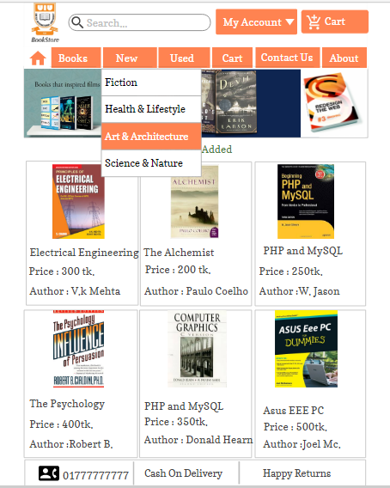
CATEGORIES PAGE

Slide 30
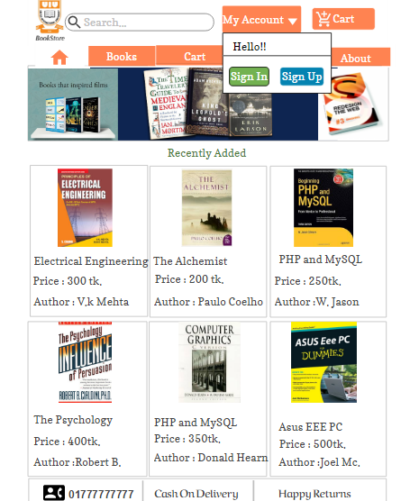
MY ACCOUNT PAGE

Slide 31
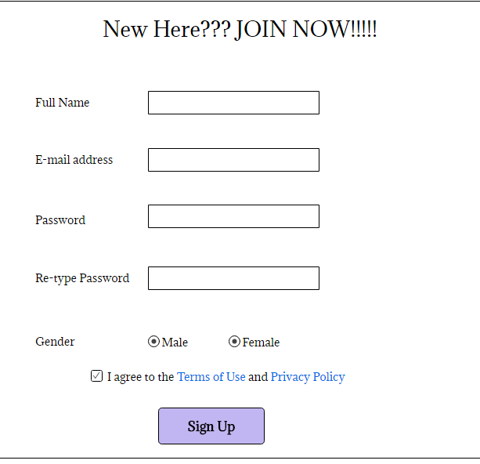
SIGN UP PAGE

Slide 32
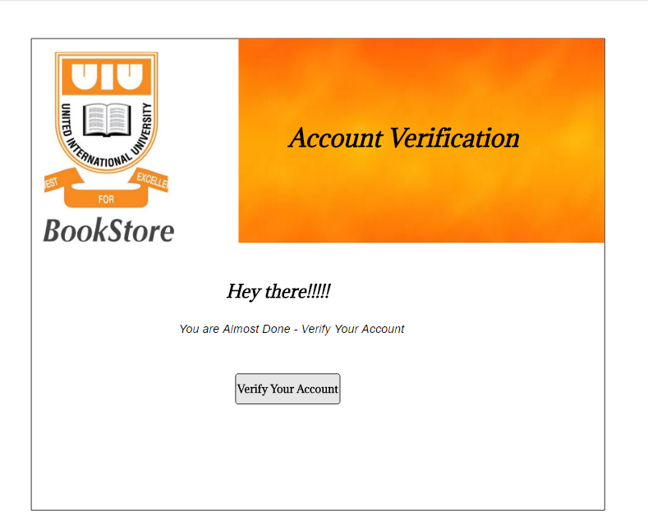
ACCOUNT VERIFICATION PAGE

Slide 33
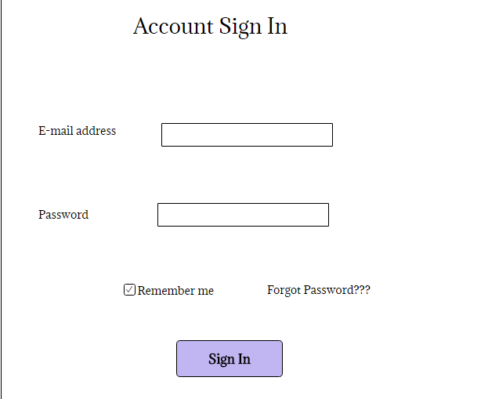
SIGN IN PAGE

Slide 34

WHEN BUYING A BOOK

Slide 35
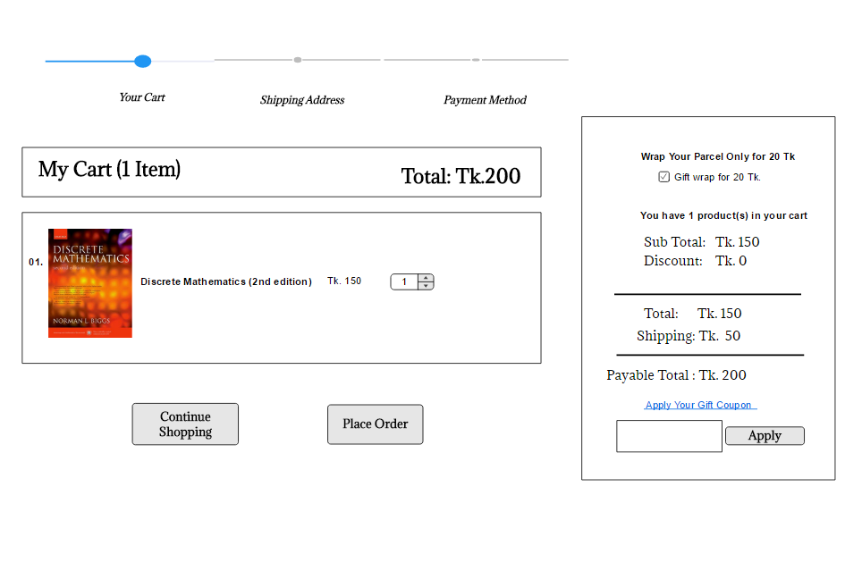
ADD TO CART
PROCESS

Slide 36
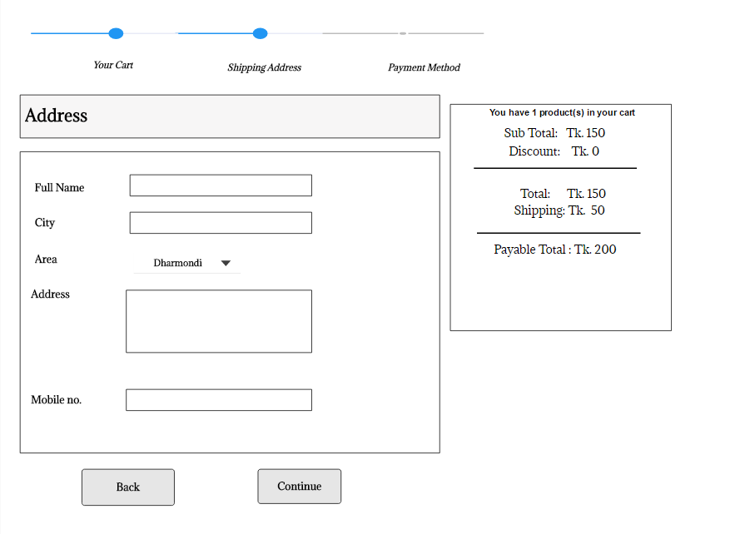
PLACE ORDER

Slide 37
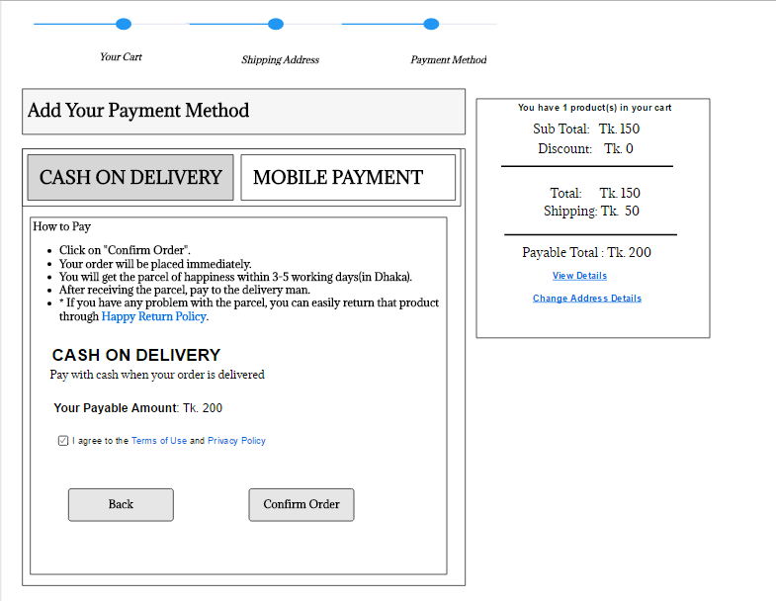
CASH ON DELIVERY

Slide 38
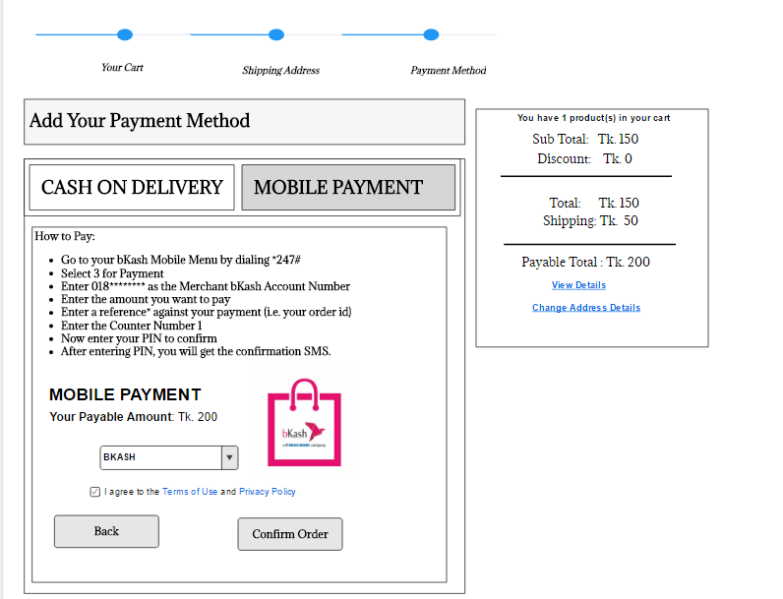
PAYMENT BY bKASH

Slide 39
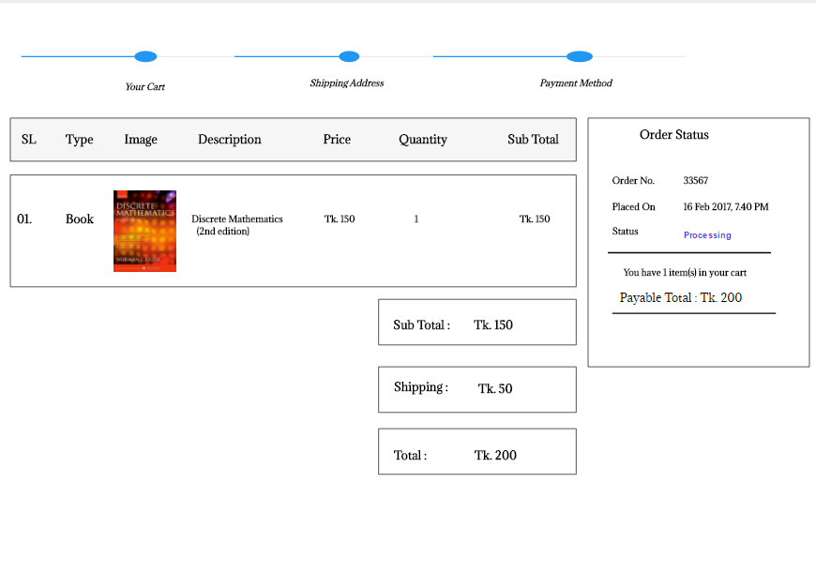
PLACING YOUR ORDER

Slide 40
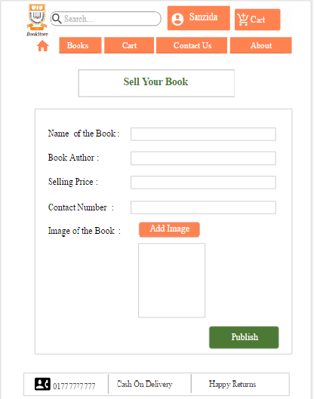
Selling book Form

Slide 41

SELLING BOOK

Slide 42
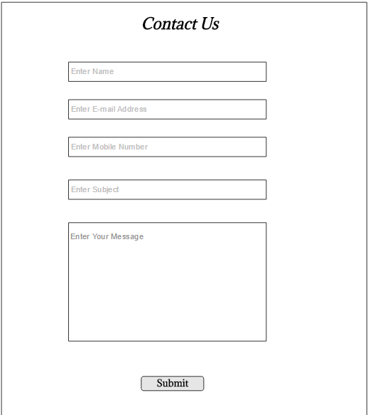
CONTACT PAGE

Slide 43
PDF of the designed page

Slide 44
DIAGRAMS

Slide 45
Context Diagram
The Context Diagram shows the system under consideration as a single high-level process and then shows the relationship that the system has with other external entities.
It has 3 main components.
Processes (circle)
External Entities (rectangle)
Data Flows (curved or straight line with arrowhead indicating flow direction

Slide 46
Creating Context Diagram Rules
a. Start by placing a single process symbol in the center of the page. The symbol represents the entire information system, and you identify it as process 0.
b. Next, place the external entities around the perimeter of the page, and use data flows to connect the entities to the central process.
c. Do not show any data stores in a context diagram because data stores are internal to the system.
d. Place the external entities around the central process and label them.
e. Create labeled input and output data flows between the external entities and the central system.

Slide 47
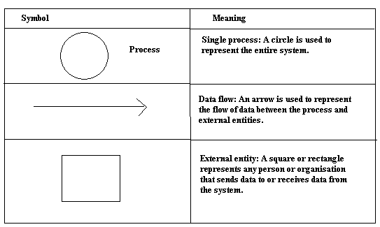
Context Diagram Symbols

Slide 48
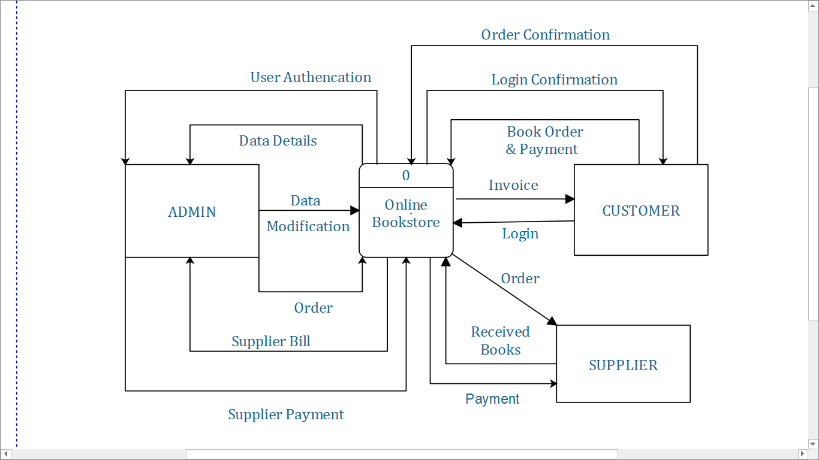

Slide 49
Data Flow Diagram
A Data-Flow Diagram (DFD) is a graphical visualization of the movement of data through an information system.
A DFD is process centric and depicts 4 main components.
Processes (circle)
External Entities (rectangle)
Data Stores (two horizontals, parallel lines or sometimes and ellipse)
Data Flows (curved or straight line with arrowhead indicating flow direction)

Slide 50
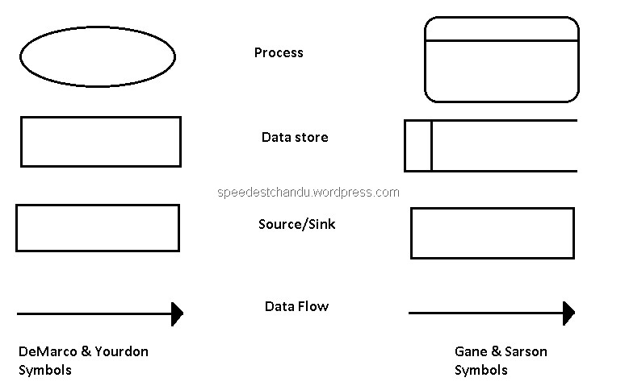
DFD Components

Slide 51
DFD Diagram Symbol Functions
Functions of each component:
Process: An activity or function performed for a specific business reason.
Data flow: A single piece of data or a logical collection of data
Always starts or ends at a process
Data store: A collection of data that is stored in some way
Data flowing out is retrieved from the data store
Data flowing in updates or is added to the data store
External entity: A person, organization, or system that is external to the system but interacts with it.

Slide 52
Data Flow Diagram Rules
Each process must have a minimum of one data flow going into it and one data flow leaving it.
Each data store must have at least one data flow going into it and one data flow leaving it.
A data flow out of a process should have some relevance to one or more of the data flows into a process.
Data stored in a system must go through a process.
Filing systems within an organisation cannot logically communicate with one another unless there is a process involved.
All processes in DFD must be linked to either another process or a data store.

Slide 53
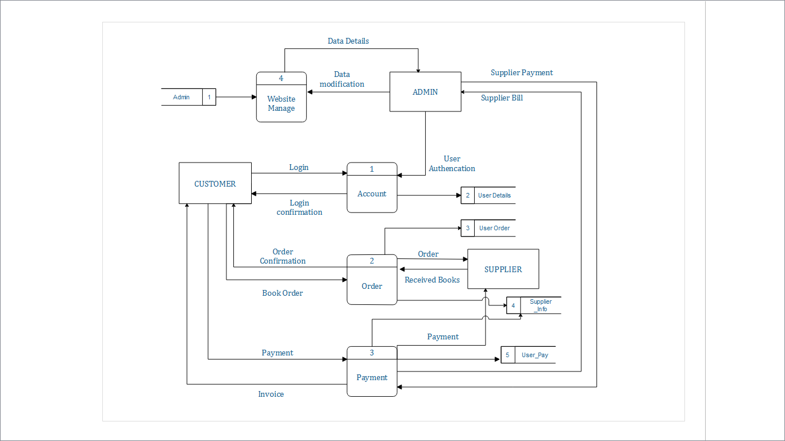

Slide 54
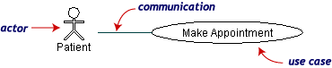
USE CASE DIAGRAM
Use case diagrams describe what a system does from the standpoint of an external observer. Or A use case diagram is a collection of actors, use cases, and their communications. The emphasis is on what a system does rather than how.
Use case diagrams are closely connected to scenarios. A scenario is an example of what happens when someone interacts with the system.
The Symbols are:
Use Case Actor Communications

Slide 55
Use case Diagram Functions
A use case is a summary of scenarios for a single task or goal. Use cases are ovals.
An actor is who or what initiates the events involved in that task. Actors are simply roles that people or objects play. Actors are stick figures.
Communications are lines that link actors to use cases.

Slide 56
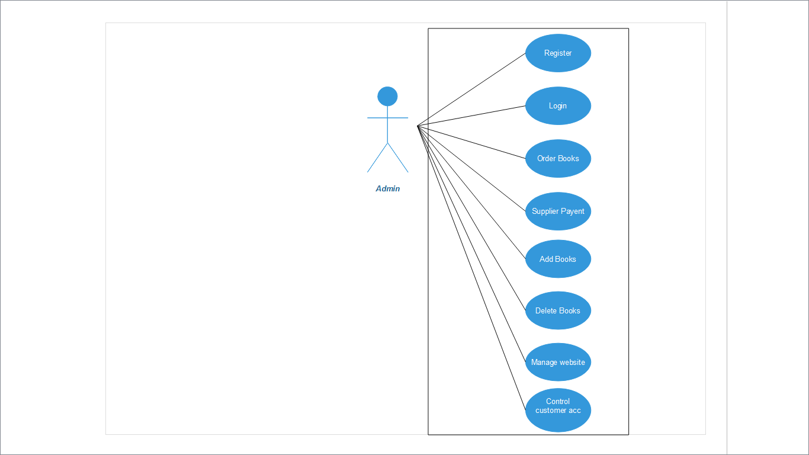
Use case Diagram

Slide 57
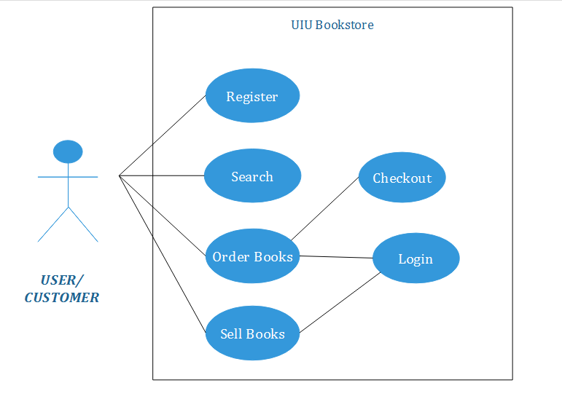

Slide 58
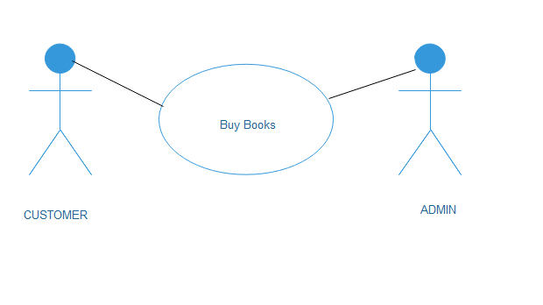

Slide 59
Use Case Diagram Descriptive form
Components required:
Use case number and name
Primary Actor
Stakeholders and Interests
Preconditions
Success Scenario
Alternate Scenario
Post-conditions

Slide 60
Use Case : Buy Books
Primary Actor: Customer
Stakeholders and Interests:
Admin: Wants to sell books with maximum profit. Wants to increase their revenue and sales and have more customers.
Customer: Wants to purchase books at a cheaper price with fast service and minimal effort. Wants receipt/invoice if future return of product is necessary.
Supplier: Wants to supply books to admin with maximum profit.
Government Tax Agencies: Wants to collect tax from every sale.
Preconditions: The website must be authenticated; security/piracy of customers have to be maintained.

Slide 61
Successful Scenario
1.Customer could easily register.
2.Customer finds their required books.
3.Customer can successfully add the products to the cart.
4.Customer gives in their address and selects the payment method.
5.Customer successfully completes their purchase and receives a purchase invoice on their email.
6.Customer receives their books/product successfully.
7. Customer details along with their purchase details get stored in the database.

Slide 62
Alternative Scenario
System fails:
1.Customer can’t register or server too busy to load.
2.Customer can’t find the required books.
3.Customer can’t add the products to the cart.
4.Customer gives in their fake address or information and doesn’t provide the correct payment method.
5.Customer can’t complete their purchase and doesn’t receive a purchase invoice on their email.
6.Customer don’t receive their books/product.
7. Customer details along with their purchase details doesn’t get stored in the database due to failed system or busy server.

Slide 63
Post Conditions
Transaction and Customer Details is saved in Database. Tax is correctly calculated. Accounting and inventory updated. Invoice is generated. Customer Receives their Product

Slide 64
Activity Diagram
An activity diagram visually presents a series of actions or flow of control in a system similar to a flowchart or a data flow diagram. Activity diagrams are often used in business process modeling. They can also describe the steps in a use case diagram. Activities modeled can be sequential and concurrent. In both cases an activity diagram will have a beginning and an end.

Slide 65
Activity Diagram Rules
rounded rectangles represent actions;
diamonds represent decisions;
bars represent the start (split) or end (join) of concurrent activities;
a black circle represents the start (initial state) of the workflow;
an encircled black circle represents the end (final state).

Slide 66
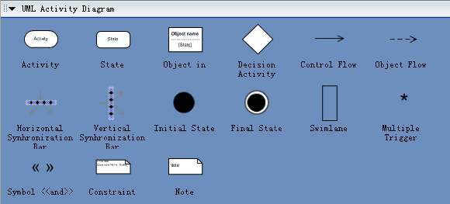
Activity Diagram Components

Slide 67
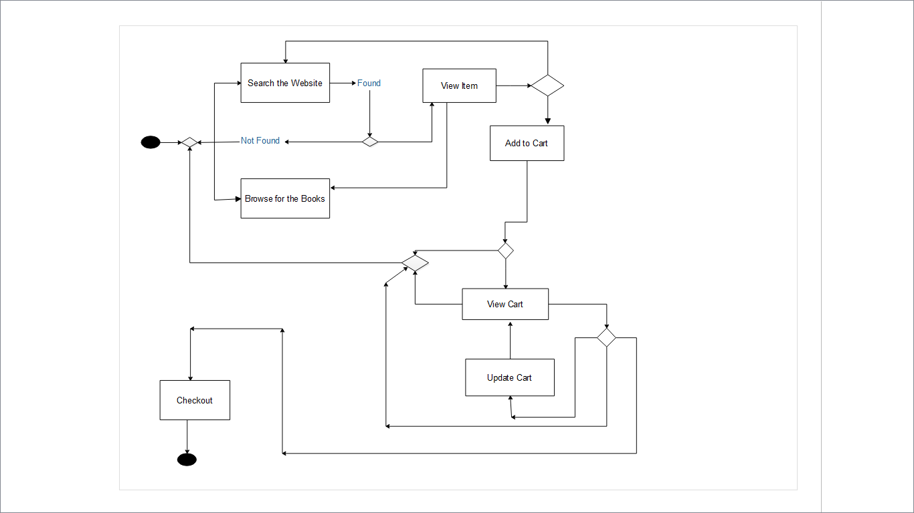
Activity Diagram

Slide 68
Class Diagram
The class diagram is a static diagram. It represents the static view of an application.
The class diagram describes the attributes and operations of a class and also the constraints imposed on the system. The class diagrams are widely used in the modelling of object oriented systems because they are the only UML diagrams which can be mapped directly with object oriented languages.
The class diagram shows a collection of classes, interfaces, associations, collaborations and constraints. It is also known as a structural diagram.
The purpose of the class diagram is to model the static view of an application.

Slide 69
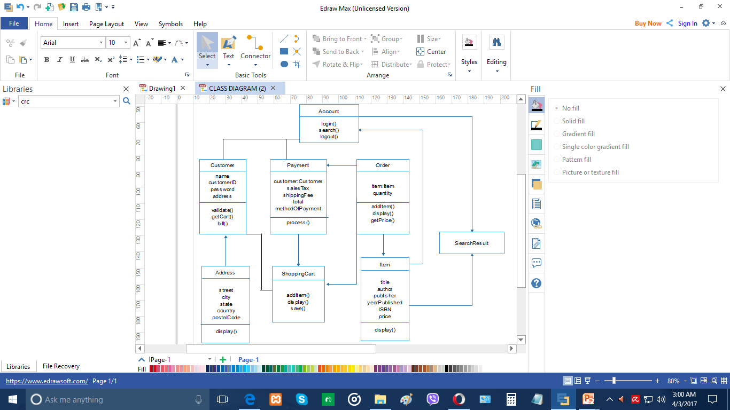
Class Diagram

Slide 70
ER Diagram
An entity relationship diagram (ERD) shows the relationships of entity sets stored in a database. An entity in this context is a component of data. In other words, ER diagrams illustrate the logical structure of databases.

Slide 71
ER Diagram Rules
Identify the entities : The first step in making an ERD is to identify all of the entities you will use. Draw a rectangle for each entity you can think of on your page. Keep them spaced out a bit.
Identify relationships : Look at two entities, are they related? If so draw a solid line connecting the two entities.
Describe the relationship : How are the entities related? Draw an action diamond between the two entities on the line you just added.
Add attributes. : Any key attributes of entities should be added using oval-shaped symbols.
Complete the diagram : Continue to connect the entities with lines, and adding diamonds to describe each relationship until all relationships have been described.

Slide 72
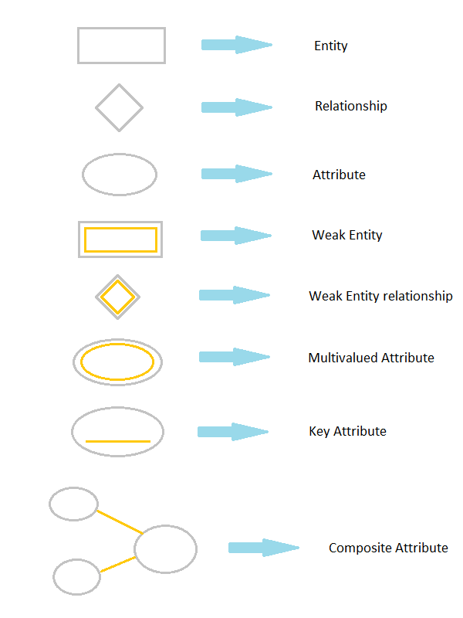
ER Diagram Components

Slide 73
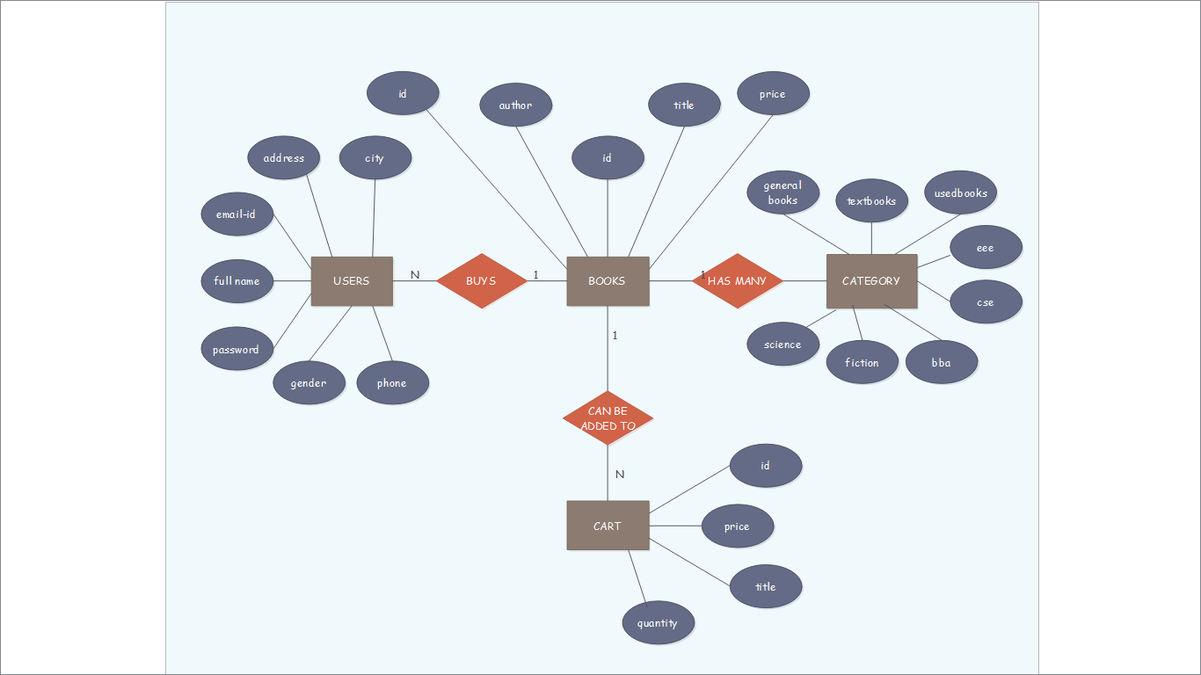
ER DIAGRAM

Slide 74
Swimlane Diagram
A swim lane (or swimlane diagram) is a visual element used in process flow diagrams, or flowcharts, that visually distinguishes job sharing and responsibilities for sub-processes of a business process. Swim lanes may be arranged either horizontally or vertically.

Slide 75
Swimlane Diagram Rules
Construction - A swimlane diagram incorporates standard symbols to display information .Each time a new actor is identified, a new column or row should be added. A circle signifies the starting and ending of an event in the process (also known as initial state and final state).
A rectangle (in BPMN or UML diagrams, these may be rounded)[8] represents an activity in the process.
A diamond represents a decision that must be made.
Arrows indicate the flow of the process.
A cylinder represents stored data.
Verbiage –
Initial state and final state (circles) should state what is being performed.[9]
The name of the action (rectangle) should describe its purpose. In activity diagrams, these generally should start with a verb.

Slide 76
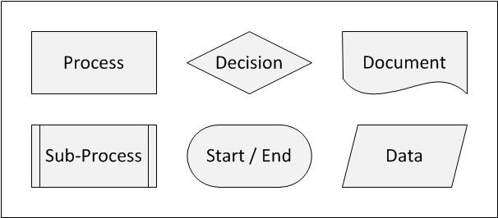
Swimlane Components

Slide 77
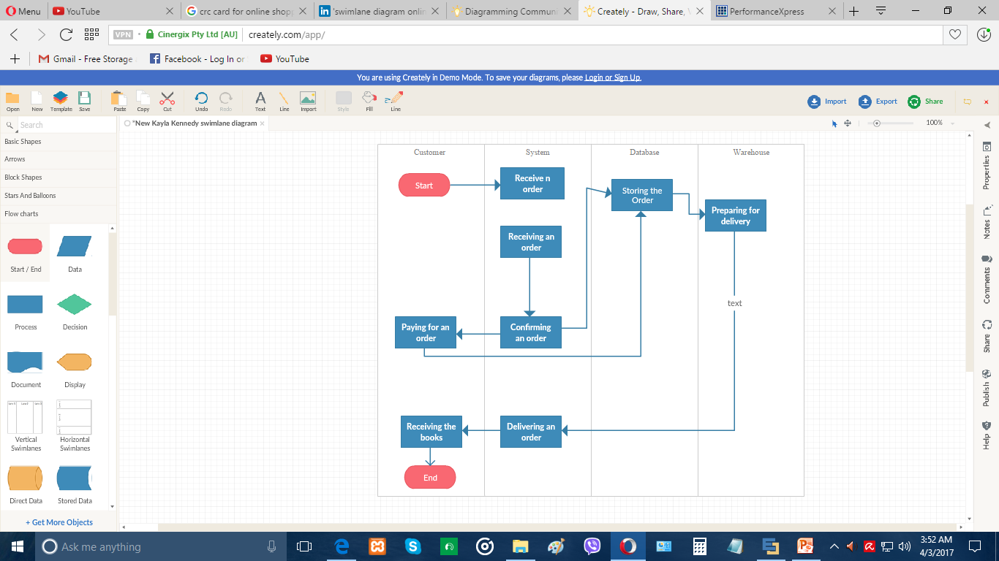
Swimlane Diagram

Slide 78
Class-responsibility-collaboration(CRC)
CRC cards are usually created from index cards. Members of a brainstorming session will write up one CRC card for each relevant class/object of their design. The card is partitioned into three areas:
On top of the card, the class name
On the left, the responsibilities of the class
On the right, collaborators (other classes) with which this class interacts to fulfill its responsibilities

Slide 79
CRC Rules
Find classes. Finding classes is fundamentally an analysis task because it deals with identifying the building blocks for your application.
Find responsibilities. You should ask yourself what a class does as well as what information you wish to maintain about it. You will often identify a responsibility for a class to fulfill a collaboration with another class.
Define collaborators. A class often does not have sufficient information to fulfill its responsibilities. Therefore, it must collaborate (work) with other classes to get the job done. Collaboration will be in one of two forms: a request for information or a request to perform a task.
Move the cards around. To improve everyone's understanding of the system, the cards should be placed on the table in an intelligent manner. Two cards that collaborate with one another should be placed close together on the table

Slide 80
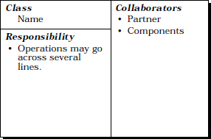
CRC Components

Slide 81
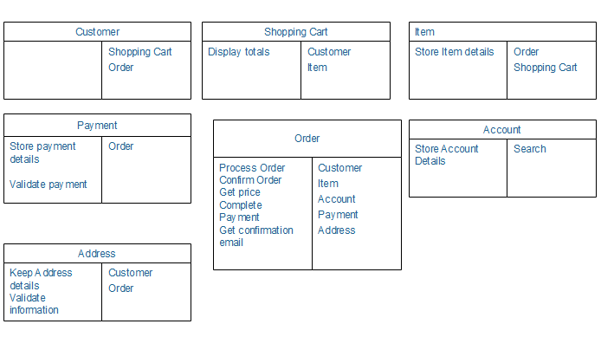

Slide 82
Sequence Diagram
Sequence diagrams describe interactions among classes in terms of an exchange of messages over time. They're also called event diagrams.
A sequence diagram is a good way to visualize and validate various runtime scenarios. These can help to predict how a system will behave and to discover responsibilities a class may need to have in the process of modeling a new system.

Slide 83
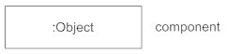
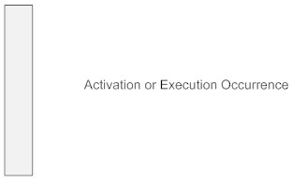
Sequence Diagram Components
Class Roles or Participants Class roles describe the way an object will behave in context.
Activation or Execution Occurrence Activation boxes represent the time an object needs to complete a task.

Slide 84
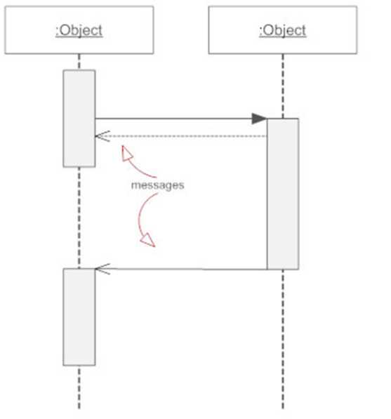
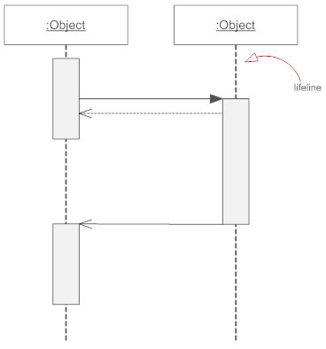
Sequence Diagram Components
Messages Messages are arrows that represent
communication between objects.
-Lifelines Lifelines are vertical dashed lines that indicate the object's
presence over time.

Slide 85
Types of Messages in Sequence Diagrams
Synchronous Message
Asynchronous Message
Reply or Return Message
Self Message
Create Message
Delete Message
Found Message
Lost Message

Slide 86
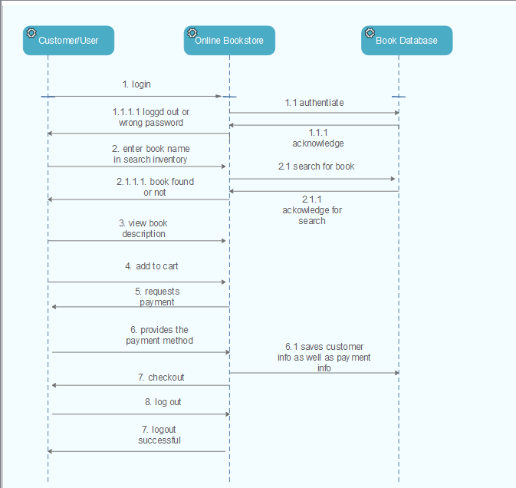

Slide 87
State Diagram
A state diagram is a type of diagram which describes the behavior of systems.
State diagrams are used to give an abstract description of the behavior of a system. This behavior is analyzed and represented as a series of events that can occur in one or more possible states.

Slide 88
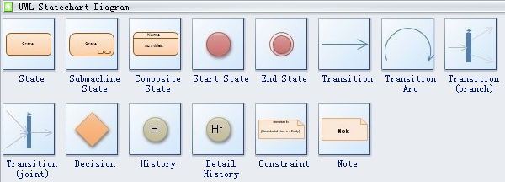
Symbols

Slide 89


Symbol description
State defines current condition of an event or activity. State diagram is ofen used to describe state changes triggered by events.
Start state symbol signals the first step of a process.
End state symbol stands for the result of a process.

Slide 90

Symbol description
Transition takes operation from one state to another and represents the response to a particular event. A single transition comes out of each state or activity, connecting it to the next state or activity.
You also have Decision, History and Constraint in the UML model element.

Slide 91
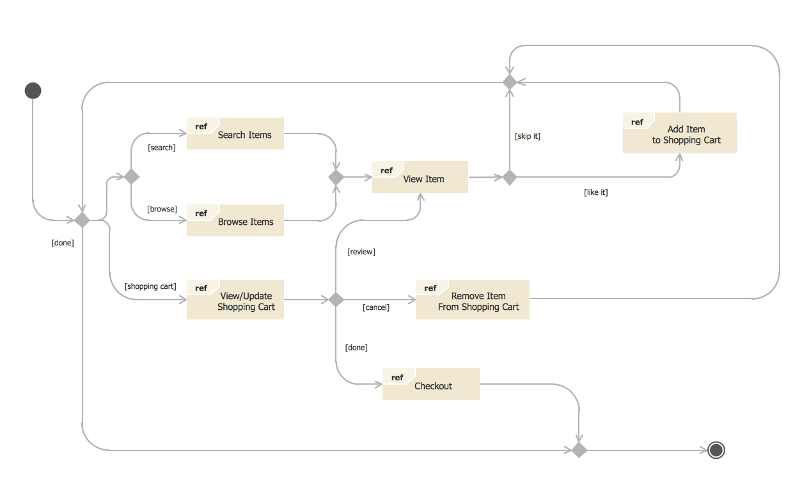

Slide 92
Website Link
https://leisurelife.000webhostapp.com

Slide 93


Slide 94
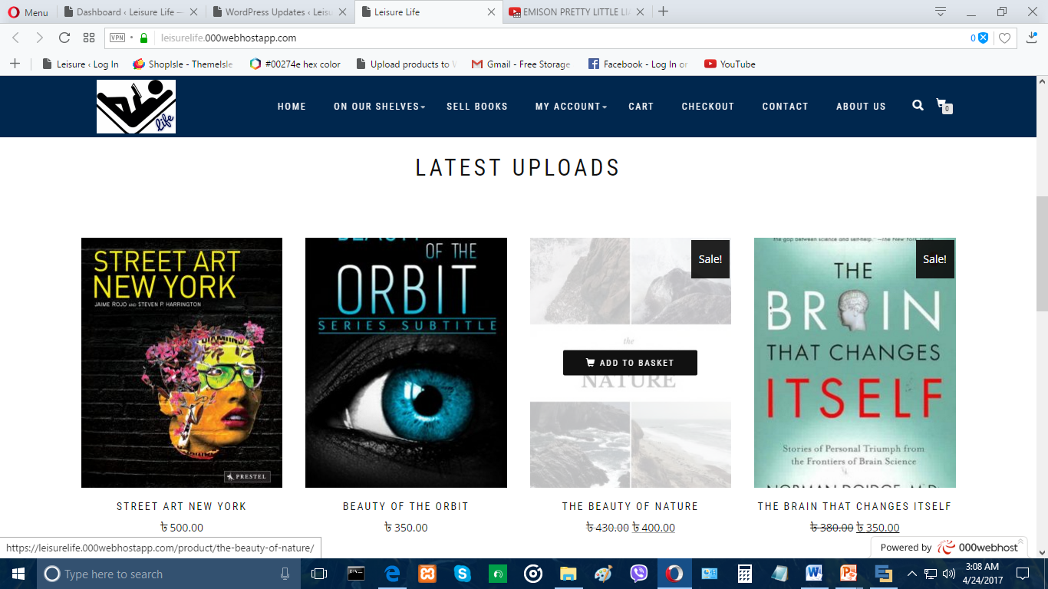

Slide 95
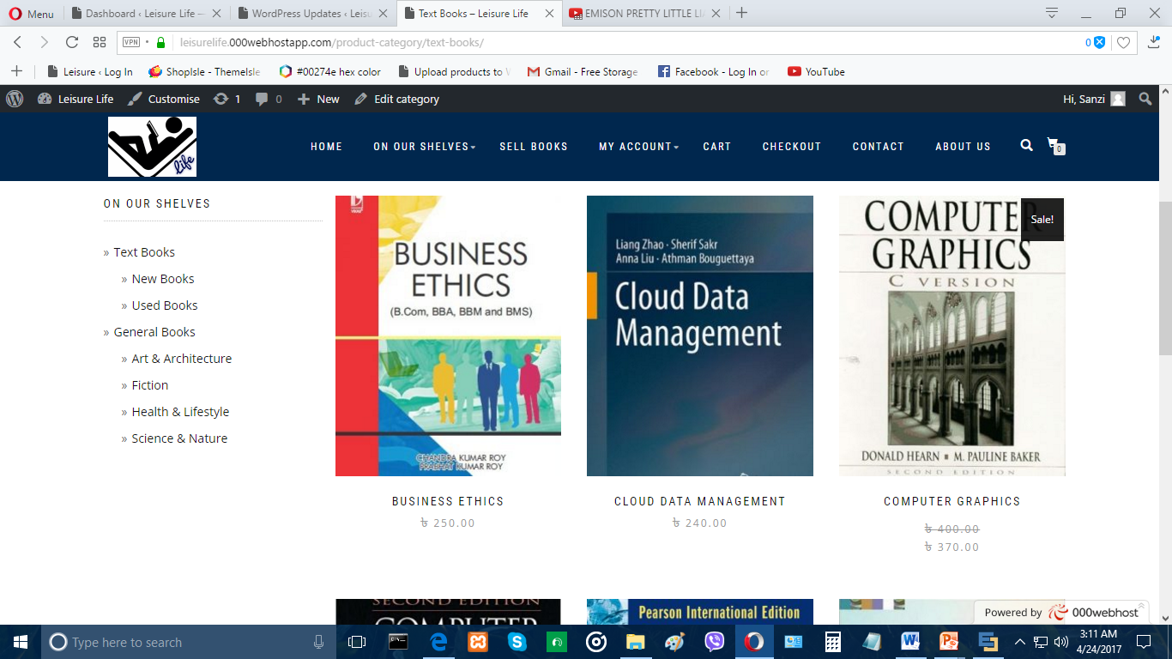

Slide 96
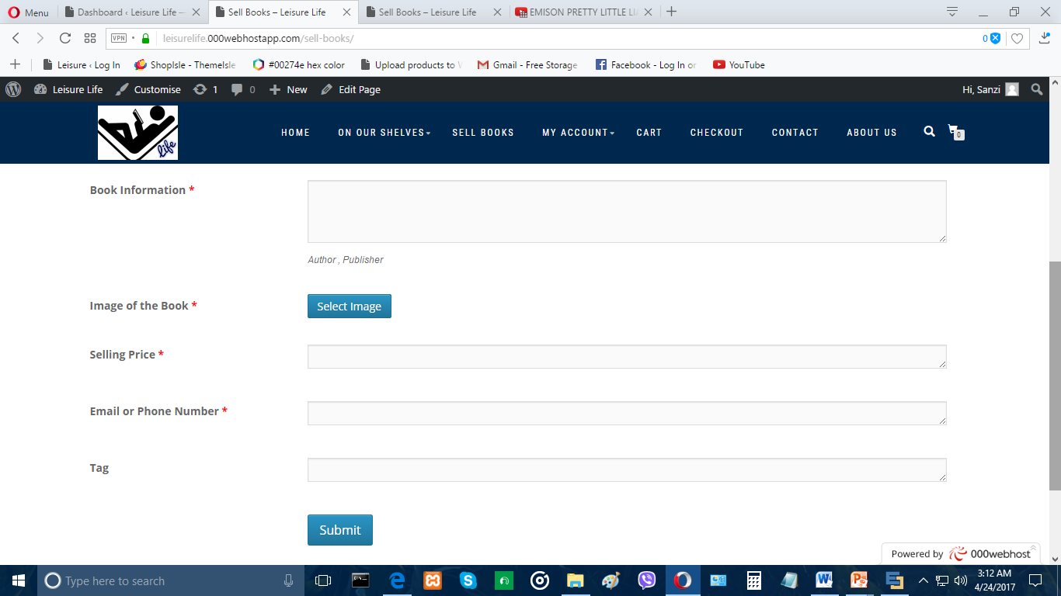

Slide 97


Slide 98


